Slide 1
Teaching Approaches and Methods

Slide 2
The Grammar-Translation Method

Slide 3
Objectives of GTM
To be able to read literature written in the target language
To be able to translate from one language to another
To develop reading and writing skill

Slide 4
Key Features of GTM
Native language
Vocabulary / grammatical rules
Accuracy /translation
Language skills

Slide 5
Advantages of GTM
An effective way for application of grammar and sentence structure
Few demands on teachers
Least stressful for students

Slide 6
Disadvantage of GTM
Wrong idea of what language is
Less learners’ motivation
Create frustration for learners

Slide 7
Application: Typical Techniques
(1) Translation of a Literary Passage
(2) Reading Comprehension Questions
(3) Antonyms/Synonyms
(4) Cognates
(5) Deductive Application of Rule
(6) Fill-in-the-blanks
(7) Memorization
(8) Use Words in Sentences
(9) Composition

Slide 8
Reading Method

Slide 9
The Purpose
For people who do not travel abroad, reading is a useful skill to learn a foreign language.

Slide 10
GTM & RM
˙Similarity
Little or no attention is given to pronunciation.
˙Diversity
GTM read difficult texts begun early
GTM has Single Vocabulary lists

Slide 11
The Characteristic
（1）Acquisition of vocabulary> Grammatical skill
（2）Control vocabulary difficulty
（3）Reading Comprehension > Pronunciation and Conversational Skills
（4）Translation reappears

Slide 12
Advantages with using RM
˙Good for people who do not travel abroad
˙Teacher does not need to have good oral skill

Slide 13
Disadvantages with using RM
˙Narrow skill ability
˙Unbalanced learning

Slide 14
Typical Procedure in a RM Course
（1）Read a lot
（2）Expand vocabulary fast

Slide 15
The Direct Method
Introduction

Slide 16
Rationale of DM
First language learning process
(1) No grammar
(2) No mother tongue
(3) No translation
(4) Postponement of printed word
(5) Postponement of written word

Slide 17
Key Features of DM
Target language
Vocabulary / grammar
Teaching point
Language skills

Slide 18
Guidelines of DM for teaching oral language
Demonstrate
Act
Ask questions
Correct
Use sentences
Make students speak much
Use lesson plan
Follow plan
Keep the pace of the students
Speak normally
Speak naturally
Take it easy

Slide 19
Advantages of DM
An effective way in creating learners to be competent in using the target language communicatively.

Slide 20
Disadvantage of DM
Difficult to implement in public secondary school education
Time-wasting
Not all teachers were proficient enough in the foreign language

Slide 21
Application: Typical Techniques
(1) Reading Aloud
(2) Question and Answer Exercise
(3) Student Self-Correction
(4) Conversation Practice
(5) Fill-in-the-blank Exercise
(6) Dictation
(7) Paragraph Writing

Slide 22
The Audiolingual Method
˙Founded during World War II for military purposes in USA
˙Popular in the 1960s but died out in the 70s

Slide 23
The Purpose
Focus on students’ pronunciation, and train their ability of listening by dialogues and drills

Slide 24
Direct Method & ALM
˙Similarity
taught language directly without using L1
˙Diversity
ALM drilled students without teaching vocabulary

Slide 25
Structural Linguistics & ALM

Slide 26
Behaviorism & ALM - principles
˙Language learning is habit-formation
˙Mistakes should be avoided
˙Spoken language comes before written language
˙Dialogues and drill centered

Slide 27
Behaviorism & ALM - elements
˙Stimulus
˙Response
˙Reinforcement

Slide 28
The Characteristic
（1） Imitation
（2） repetition
（3） Positively reinforced
（4） Over learn
*Emphasis on the “Form”,
not the “Meaning”

Slide 29
Advantages with using ALM
˙Allows Students to communicate quickly

Slide 30
Disadvantages with using ALM
˙Turns Students into parrots
˙Boring and mindless
˙Reduces the motivation

Slide 31
Typical Procedure in an ALM Course
（1）hear a dialogue
（2）repeat the dialogue
（3）key words or structures changed
（4）practice substitutions in the pattern drills

Slide 32
The Cognitive Approach
Introduction & Rationale

Slide 33
Key Features
Instruction is often individualized
Vocabulary / grammar
Language skills
Demands on teachers

Slide 34
Application: Cognitive approach to grammar teaching
Grammar teaching should be planned and systematic
Necessary grammar instruction
Extensive exposure to instructed grammar points
Production activities
Group work and task performance
Post lesson activities

Slide 35
Total Physical Response/TPR (James Asher , 1966)
founded by James Asher, a professor of psychology at San José State University, California, USA

Slide 36
The Purpose
To have basic oral expression ability through using imperative sentences.

Slide 37
The Characteristic
（1）retention
（2）Direct commands
（3）No stress
（4）Listen first
*Emphasis on “Meaning”,
not “Form”

Slide 38
Advantages with using TPR
˙Fun.
˙Memorable.
˙Good for kinesthetic learners.
˙No matter the class size.
>>>

Slide 39
Advantages with using TPR
˙Works well with mixed-ability classes.
˙No requirement for many preparation or materials.
˙Effective with young learners.
˙Involves both left and right-brained learning

Slide 40
Disadvantages with using TPR
˙Students feel shy
˙Less useful for upper levels
˙overuse TPR

Slide 41
Typical Procedure in a TPR Course
（1）input
（2）comprehension
（3）express

Slide 42
Oral-Situational Approach
Developed in Britain and popular between the 1930s and 1960s

Slide 43
Main difference between DM and OSA
Oral-Situational Approach has a systematic planed vocabulary and grammar rules, DM hasn’t.

Slide 44
Main difference between ALM &OSA
Oral-Situational Approach doesn’t focus on reinforcement, ALM does.

Slide 45
Purpose
Teaching a practical skill of L2 through copy the way children acquire L1

Slide 46
Characteristic
˙Start from spoken language
˙Avoid errors
˙Teacher-centered
˙Focus on Listening and speaking
˙Chosen the vocabulary

Slide 47
Advantages with using OSA
˙Brings the reality situation in the classroom
˙Scheduled progress

Slide 48
Disadvantages with using OSA
˙Turns students into parrots
˙Boring and mindless
˙Reduces motivation

Slide 49
Typical Procedure
˙Teacher gives a topic
˙Demonstrate with teaching aids
˙Key word changed

Slide 50
Suggestopedia
The name is from the words suggestion and pedagogy.
Developed in the 1970s by the Bulgarian psychologist Georgi Lozanov

Slide 51
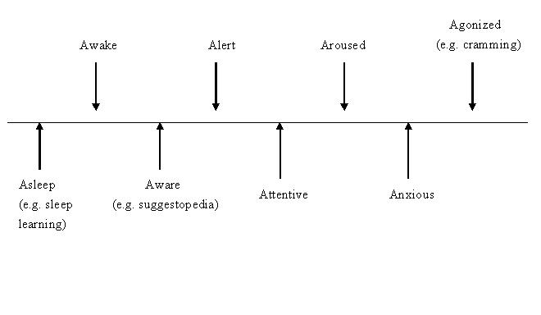
Attention and memory studies
(Adapted from: Richards & Rodgers 2001 Approaches & Methods in Language Teaching Cambridge)

Slide 52
Purpose
Desuggest the psychological barriers to learn vocabulary and conversation

Slide 53
Characteristic
˙Present text with music
˙Practiced breathing
˙Comfortable
˙Choose target language name
˙Colorful posters on the wall
˙Liberate instead of teach

Slide 54
Elements to Suggestopedia
˙Authority
˙˙Intonation,
Rhythm and concert pseudo-passiveness

Slide 55
Advantages with using Suggestopedia
˙Increases oral proficiency
˙Lowers classroom anxiety

Slide 56
Disadvantages with using Suggestopedia
˙Unavailable of music and comfortable chairs
˙No advanced comprehension technique

Slide 57
Typical Procedure
˙Deciphering
˙Concert session
˙Elaboration
˙Production

Slide 58
Community Language Learning
Developed by Charles Curran and his associates in 1970s

Slide 59
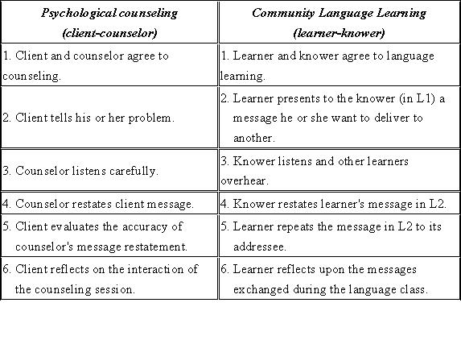
Comparison

Slide 60
Psychological Requirements for Successful Learning
˙S stands for security
˙A stands for attention and aggression
˙R stands for retention and reflection
˙D represents discrimination

Slide 61
Purpose
The teacher can successfully transfer his or her knowledge and proficiency in L2 to the students; Specific purposes are not mentioned.

Slide 62
Characteristic
˙Client-Counselor and Learner-Knower relationships
˙Humanistic Techniques

Slide 63
Advantages with using CLL
˙Removes the feeling of distance and insecurity
˙Counselor allows the learner to decide on the topic

Slide 64
Disadvantages with using CLL
˙Teacher may become too indirective
˙Confidence based on an inductive strategy for learning

Slide 65
Typical Procedure
˙Translation
˙Group Work
˙Recording
˙Transcription
˙Analysis
˙Reflection and observation

Slide 66
Main Steps of Procedure of CLL
˙Investment
˙Reflection

Slide 67
The Comprehension-based Approach
(Natural Approach)
Introduction

Slide 68
Features of NA
Listening comprehension is very important
Begin by listening to meaningful speech
Speak when ready
One step beyond their level of competence
Error correction
Appropriate input for the learners
Adopt freely from various method sources

Slide 69
The NA v.s. The DM
The NA emphasis on
1.Exposure / input
2.Optimizing emotional preparedness
3.A prolonged period of hearing
The DM emphasis on
1.Teach monologues
2.Direct repetition
3.Formal Q/A
4.Accurate production

Slide 70
Objectives of NA
To be able to function adequately in the target situation.
To be able to convey their requests and idea

Slide 71
Teacher and Student Roles
Teacher Roles
The primary source
Create a classroom atmosphere
Choose a rich mix of classroom activities
Student Roles
Participator ; responder

Slide 72
The Communicative Approach
Introduction

Slide 73
Features of CA
Communicative intent
The use of authentic materials
Activities are often carried out

Slide 74
Teacher and Student Roles
Teacher roles
(1) To facilitate communication
(2) To be a co-communicator
Student roles
Communicator

Slide 75
Advantages of the CA
(1) Students will be more motivated
(2) Students have opportunities to express
(3) Student security is enhanced

Slide 76
Disadvantages of the CA
Difficulty in evaluating students’ performance
Ignores the teaching of reading and writing

Slide 77
Typical techniques
Authentic materials
Scrambled sentences
Language games
Picture strip story
Role play

Slide 78
Task-Based Approach
Introduction

Slide 79
Principles of TBA
Tasks provide both the input and output processing
Task activities and achievement are motivational
Learning difficulty can be negotiated and fine-tuned

Slide 80
Teacher and Student Roles
Teacher roles
(1) Selector and sequencer of tasks
(2) Preparing learners for tasks
(3) Consciousness-raising
Student roles
(1)Group participant
(2)Monitor
(3)Risk-Taker and innovator

Slide 81
Advantages of TBA
(1) Students are free of language control
(2) Students have more varied exposure to
language
(3) Enjoyable and motivating

Slide 82
Disadvantages of TBA
focus on meaning could come at the expense of focus on form

Slide 83
Typical techniques
Lesson plans should be designed to cover 3 stages in the TBA
(1)Pre-task stage
(2)During-task stage
(3)Post-task stage

