Slide 1
Standards- Based Approach
Brahim Hadad
CASABLANCA CRMEF

Slide 2
The outline:
Introduction
Definition.
The types of Standards.
The premise behind Implementing SBA in EFL.
Areas of the five C’s.
Implementing five C’s while planning.
Conclusion

Slide 3
Definition:
"Standard" has been defined as: "What students should know and be able to do at the end of the process of the language study. Standards-based refers to the practice of making sure students learn what they were taught and actually achieve the expected standards . Standards-based is focused on outputs (what is learned),

Slide 4
Types of Standards:
Content Standards:
Are statements about what learners should know and be able to do with English .
Performance Standards:
Show us how the learners have achieved the standard targeted.
Proficiency Standards:
These standards tell us how well learners should perform.

Slide 5
The premise behind Implementing SBA in EFL
The standards have been designed to meet the following purposes:
•Acknowledge the value of both the content and skills that students learn through English.
• Adopt the Performance-based assessment as a source for a reliable assessment.

Slide 6

Components of five C’s
Connections
Cultures
Communication
The five C’s
Comparisons
Communities

Slide 7
Areas of the five C’s
Communication
Communities
Connections
Cultures
Comparisons
1
2
3
4
5
Interpersonal
Interpretive
Presentational
Life long Learning
Technologies
Connecting to other fields
Viewpoint
Perspectives
Practices
Products
Linguistic point of view
Cultural point of view

Slide 8

Implementing SBA in EFL classrooms:
establishes
clear learning
goals for the
students
Organizes
learning around
what students need to know and be able to do to reach high levels of
performance
Teacher’s role
demonstrates,
shares, and guides students to independence
is facilitator
of student’s learning

Slide 9
The learner’s role in SBA
  should
  take responsibility of
  their own learning
Should appear actively engaged in his/her own learning
  must fully participate and put forth effort within their group

Slide 10
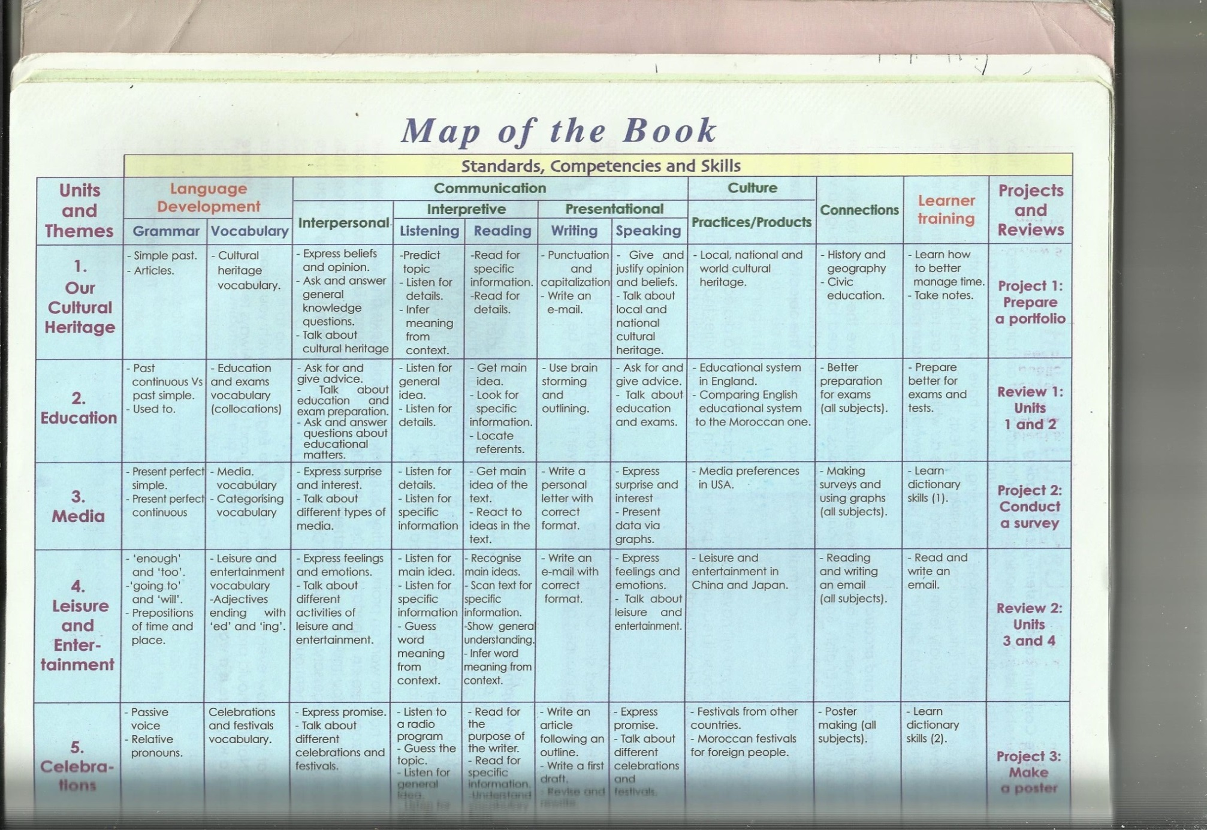
Example1

Slide 11
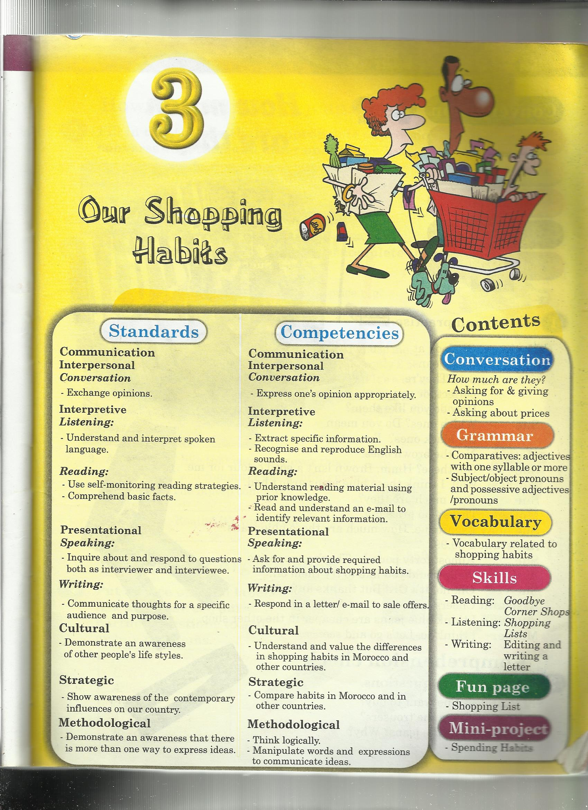
Example2

Slide 12
References
English Language Guidelines for Secondary Schools. (2007).
https://blogs.commons.georgetown.edu
http://edglossary.org/standards-based/
Gateway2 to English, teacher’s book Nadia Edition 1st Edition 2007/2008

