Slide 1
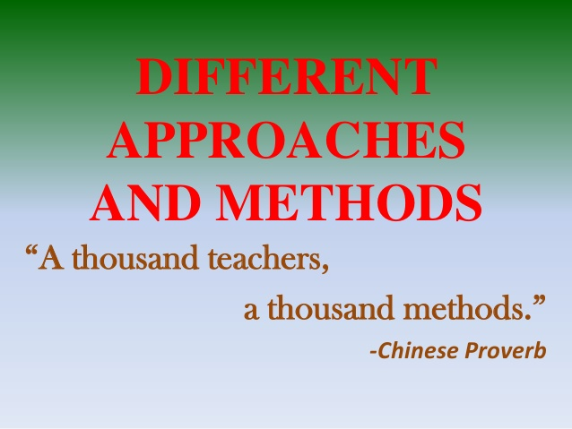

Slide 2
GRAMMAR TRANSLATION METHOD
Richards and Rodgers (2001) observe that the Grammar-Translation Method is a way of studying language first through a detailed analysis of its grammar rules, followed by application of this knowledge to the task of translating sentences and texts into and out of the target language. It views language learning as consisting of little more than memorising rules and facts in order to understand and manipulate the morphology and syntax of the foreign language.
The teacher is the authority in the classroom, the learners do as the teacher says so that they can learn what the teacher knows. Interaction in the classroom is from the teacher to the learner. There is little student initiation and little learner-learner interaction (Qing-xue and Jin-fang 2007).
Krashen (1982) explains that the method failed because learners were not able to speak the language fluently since the focus was sorely on form and not meaning.

Slide 3
AUDIO-LINGUALISM
In the audio-lingual method, the emphasis was on the memorization of a series of dialogues and the practice of language structures. The basic premises on which the method was based were that language is speech, not writing, and language is a set of habits. It was believed that much practice of the dialogues would develop oral language proficiency. The use of the native language was avoided.
The major weakness of the audio-lingual method was that learners were not able to transfer skills learnt in class to communicate meaningfully outside the classroom.
The Audio-lingual Method is a method of foreign language teaching which emphasizes the teaching of listening and speaking before reading and writing. It uses dialogues as the main form of language presentation and drills as the main training techniques. Mother tongue is discouraged in the classroom

Slide 4
COMMUNICATIVE LANGUAGE TEACHING
Halliday (1978), the communicative approach derives its influence from functional linguistics, in which language is viewed as central to understanding language systems and how they work.
The grammar and vocabulary taught in the classroom will follow from function, situation or context, and the different roles of the interlocutors. In terms of the roles of the teacher and the learners in the classroom, the role of the teacher is. On the other hand, students need the to facilitate classroom interaction by way of coming up with situations that can bring about communicationknowledge of the linguistic forms, meaning and functions. Learners should be able to negotiate meaning in communication, know that one form can save various functions, and they must also be able to choose the most appropriate forms, given the social context (Qing-xue and Jin-fang 2007).

Slide 5
The language used to communicate must be appropriate to the situation, the roles of the speakers, the setting and the register.
Communicative activities are essential. Activities should be presented in a situation or context and have a communicative purpose. Typical activities of this approach are: games, problem-solving tasks, and role-play
Learners must have constant interaction with and exposure to the target language.
Development of the four macroskills — speaking, listening, reading and writing — is integrated from the beginning, since communication integrates the different skills.
Motivation is central. Teachers should raise students’ interest from the beginning of the lesson.
The role of the teacher is that of a guide, a facilitator or an instructor.
Evaluation concerns not only the learners’ accuracy but also their fluency.
Contextualization is a basic premise. (Meaning cannot be understood out of context)

Slide 6
COMPETENCY BASED APPROACH
Mrowicki (1986, as cited in Weddle, 2006) defines competencies as follows: Competencies consist of a description of the essential skills, knowledge, attitudes, and behaviors required for effective performance of a real-world task or activity. These activities may be related to any domain of life, though have typically been linked to the field of work and to social survival in a new environment. (p. 2) Richards and Rodgers (2001) cite Docking (1994) who defines competency as An element of competency can be defined as any attribute of an individual that contributes to the successful performance of a task, job, function, or activity in an academic setting and/or a work setting. This includes specific knowledge, thinking processes, attitudes, and perceptual and physical skills. (p. 145) Therefore, competency might be a task, a role, a function which changes over time, and will vary from context to context. According to Richards and Rodgers (2001), competency-based language teaching (CBLT) focuses on outcomes of learning. CBLT addresses what the learners are expected to do rather than what they are expected to learn.

Slide 7
The term standard refers to “what students should know and be able to do” (Nunan, 2007, p. 428).
There are several advantages of a CBLT. First of all, CBLT focuses “on language as a tool for communication rather than on language knowledge as an end in itself” (Nunan, 2007, p. 425). It promotes responsible and accountable teaching (Findley & Nathan, 1980). Referring to benefits of CBE, Norton (1987, as cited in Sullivan, 1995) states that in CBE learners’ confidence is enhanced because they can achieve competencies required in the performance in real life. Another benefit is that, the instructor in CBE is a facilitator and more training time is devoted to working with learners individually or in small groups rather than presenting lectures. Richards and Rodgers (2001) mentions four advantages of a competencies approach: 1. The competencies are specific and practical and can be seen to relate to the learner’s needs and interests. 2. The learner can judge whether the competencies seem relevant and useful. 3. The competencies that will be taught and tested are specific and public — hence the learner knows exactly what need to be learned. 4. Competencies can be mastered one at a time so the learner can see what has been learned and what still remains to be learned. (pp. 146-147)

Slide 8
As a result, we note that the essence of the new paradigm of education can be characterized by the following factors:
The displacement of the main emphasis from mastering the large amounts of information to master the methods of continuous acquisition of new knowledge and the ability to learn independently;
The mastering of skills to work with any information, with mixed, contradictory data, forming the skills of independent, critical way of thinking;
The gradual change of the traditional principle "form of knowledge and skills" to the principle "to form professional competence."

Slide 9
PPP
The first stage is the presentation of an aspect of language in a context that students are familiar with.
The second stage is practice, where students will be given an activity that gives them plenty of opportunities to practice the new aspect of language and become familiar with it whilst receiving limited and appropriate assistance from the teacher.
The third stage is production where the students will use the language in context, in an activity set up by the teacher who will be giving minimal assistance,

Slide 10
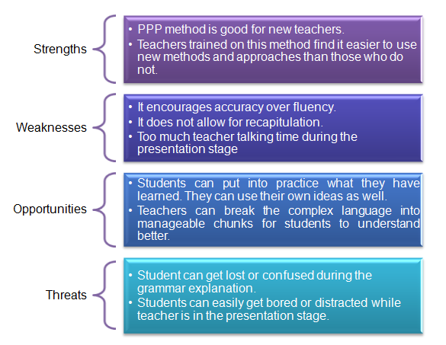

Slide 11
ECLECTICISM
Brown (2002) argues that eclecticism provides the solution because the approach allows the teacher to select what works within their own dynamic contexts. Gilliland, James and Bowman (1994) stated that the justification for the eclectic approach lies in the weaknesses of the single approach because a single method has a narrow theoretical basis and has a delimited set of activities and is therefore inflexible.

Slide 12
Gao (2011) states that principled eclecticism challenges the teacher to ensure that every decision about classroom instruction and activities is based on a thorough and holistic understanding of all learning theories and related pedagogies, in terms of the purpose and context of language teaching and learning, the needs of the learners, materials available, how language is learnt and what teaching is all.
It is not a concrete, single method. He adds that the current preferred teaching methods are an integration of Grammar-Translation, structural method and CLT and advises teachers to take advantage of all other methods whilst avoiding their disadvantages.

Slide 13
one of the premises of eclecticism is that teaching should serve learners not methods. Thus, teachers should feel free in choosing techniques and procedures inside the classroom. There is no ideal approach in language learning. Each one has its merits and demerits. There is no royalty to certain methods. Teachers should know that they have the right to choose the best methods and techniques in any method according to learners‘ needs and learning situation. Teachers can adopt a flexible method and technique so as to achieve their goals.

Slide 14
Features of the Eclectic Approach
Ali (1981:7) lists the following principles of eclecticisms:
Teachers are given a chance to choose different kinds of teaching techniques in each class period to reach the aims of the lesson.
There is flexibility in choosing any aspect or method that teachers think suitable for teaching inside the classroom
Learners can see different kinds of teaching techniques, using different kinds of teaching aids, that help to make lessons much more stimulating and ensures better understanding of the material on the other hand.
Catering for different learning needs and styles.
Solving difficulties that may emerge from the presentation of the textbook materials
Finally, it saves both time and effort in the presentation of language activities

Slide 15
LEARNERS’ ROLES
Learners are the centre of the class. They have multiple roles. As individuals, they are active participants of the activity, explorer of the language, negotiator and evaluator of the learning process. Their needs and interests influence the course. As a group member, the learner is the source of the input and part of a support system. Students work cooperatively in classroom activities. Their output is the others‘ input. They help each other in solving problems rather than depending wholly on the teacher. We can use group discussion in solving the problems so as to encourage independence. In a word, the learner takes initiative in the classroom.

Slide 16
Advantages of the Eclectic Approach
It is easier for learners to understand the language of the text in its cultural context
It blends listening, speaking, reading and writing
Helps teacher to teach effectively by drawing on the strength of various methods and avoiding their weaknesses
Learning is easy due to the use of realistic situations in the classroom

Slide 17
Drawbacks
Brown (1994:74) notes that ―theoretical eclecticism is suspicious on logical and theoretical grounds [and] without principles, eclecticism is likely to fall into a state of arbitrariness‖. Weidemann (2001) notes the following disadvantages of the eclectic approach:
It cuts teachers off from a reconsideration of their professional practices. In a word, it discourages them to reflect upon their teaching. They have made up their minds; they will use anything that works which can obtain results and is safe from ideological excesses.
Adopting the eclectic approach can be unsafe as a teacher may fall victim of the methodological baggage that comes with it.

Slide 18
Mixing all manner of methods and approaches may result in gathering in one‘s teaching arsenal; but using such a mixed bag can lead to all kinds of conflicts.
When introduced to new methods and techniques, teachers, in their haste to integrate these into their traditional styles of teaching forget about the rationale for the techniques altogether.
If an innovative technique is used only occasionally, and mixed in with other (potentially contradictory ones), the effect of the new is diluted.

Slide 19
MISCONCEPTIONS
the eclectic approach is and should be viewed as one approach except that it embraces characteristics of more than one method. Thus, embracing features of more than one method does not mean that using the eclectic method is using several isolated methods.
if pupils are fluent in the target language. They mentioned pupils‘ poor language background as an inhibitor to the use of the eclectic approach, and Respondents explained that some pupils could not speak English, and this problem was worse in rural areas than in urban areas.

Slide 20
POST METHOD ERA
Kumaravadivelu (2006) actually warns against relying on methods in their specifications because they do not provide all solutions to language teaching. He instead proposes a post-methodic approach to language teaching. Discussing pedagogical parameters of particularity, practicality and possibility as well pedagogic indicators of the post-method teacher and learner, she suggests that a language teacher should adopt a context-sensitive pedagogic

Slide 21
principled pragmatism is based on the pragmatics of pedagogy where “the relationship between theory and practice, ideas and their actualization, can only be realized within the domain of application, that is, through the immediate activity of teaching” (Widdowson, 1990, p. 30). Principled pragmatism thus focuses on how classroom learning can be shaped and reshaped by teachers as a result of self-observation, self-analysis, and self-evaluation. One way in which teachers can follow principled pragmatism is by developing what Prabhu (1990) calls “a sense of plausibility.” Teachers’ sense of plausibility is their “subjective understanding of the teaching they do” (Prabhu, 1990, p. 172).

Slide 22


Slide 23
Gaitan and Oprandy (1990) argue that there is no convincing evidence from pedagogic research, including research into second language instruction, that there is any universal or ‘best‘ way to teach language. They further state that while particular approaches are likely to prove more effective in certain situations than others.
Nunan (1991:228) is probably correct when he remarks that ―it has been realised that there never was and probably will never be a method for all‖. Since none of the methods discussed in the section above could be used effectively in isolation from other methods, the idea of Eclecticism – a conscious blending of different methods - was developed. It must be mentioned here that in this paper, the term Eclecticism will be used synonymously to Principled Eclecticism.

Slide 24
Gao (2011) states that principled eclecticism challenges the teacher to ensure that every decision about classroom instruction and activities is based on a thorough and holistic understanding of all learning theories and related pedagogies, in terms of the purpose and context of language teaching and learning, the needs of the learners, materials available, how language is learnt and what teaching is all.
Teaching should serve learners , not methods. To state that methods should serve learners and not methods means that teachers should focus on helping learners to learn and not on fulfilling the prescriptions of the methods.
Various methods reveals various learning styles, teaching principles and educational objectives.

Slide 25
